Slide 1

SUMMARY OF THE 2019/20 TABLED ANNUAL REPORT
PRESENTED TO MPAC
AUGUST 2021

Slide 2
Overview of the presentation
1. Vision, mission and values and strategic objectives of the municipality for 2019/20.
2. Smart city six pillars.
3. Brief Profile of Polokwane Municipality.
4. New Polokwane Map.
5. Socio Economic Profile.
6. Population Growth Trends.
7. Economic Information
8. Annual Report legislative framework.
9. Statutory Annual Report Process.

Slide 3
Overview of the presentation
10 - 21. Audited Financial Statements and Financial Performance against Original and Revised Budget for 2019/20.
22. Performance against IDP and SDBIP targets for 2019/20 financial year (original and revised/adjusted targets).
23. Challenges faced by the municipality in providing services
24. Measures taken to improve performance challenges in the 2019/20
25. Auditor General’s report – 2019/20 financial year and audit opinion.
26. PHA Annual Report

Slide 4
1. Vision and Mission
Vision
“The Ultimate in Innovation and Sustainable Development”
Mission
“Provide cost effective services which promote sustainable livelihood through socio economic development and good governance”

Slide 5
1. Values Statement
Values | Description
Sustainable Development | Economic, Social and Environmental friendly approach in the development of our Smart City.
Innovation | Smart way to deliver services differently
Responsiveness | Proactive response to the needs of the community by treating them as customers in a timely and considerate manner
Value Statement: Sustainable Development through Responsive Innovation

Slide 6
1. Strategic Objectives for 2019/20
Improved provision of basic and environmental services in a sustainable way to our communities.
Enhanced financial viability and improved financial management.
Improved efficiency and effectiveness of municipal administration.
Improve community confidence in the system of local government.
Increased economic growth.

Slide 7
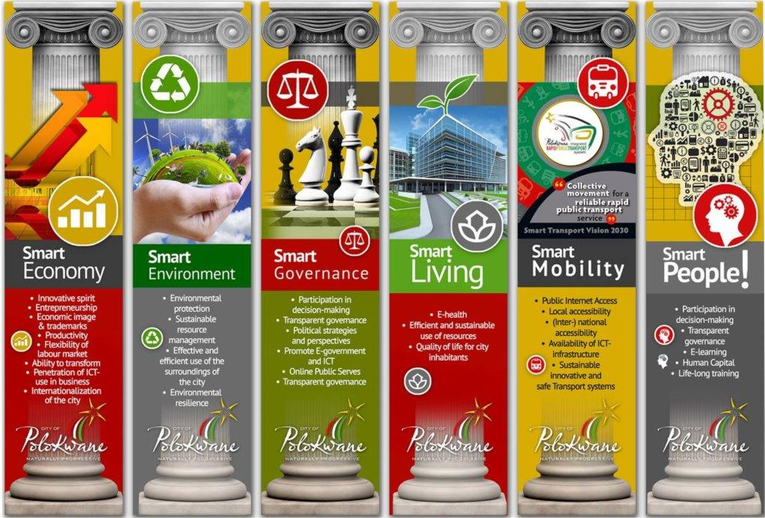
2. Smart city Six pillars

Slide 8
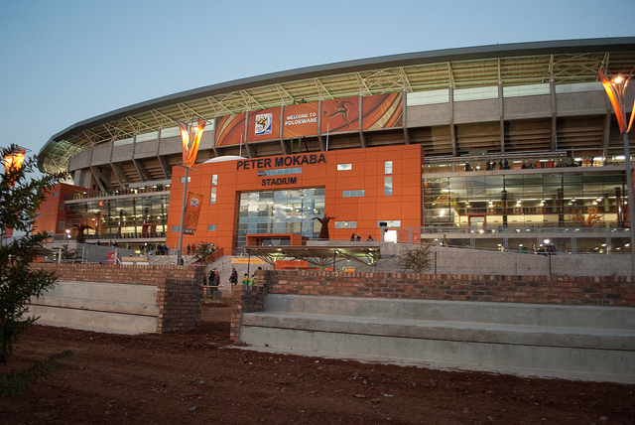
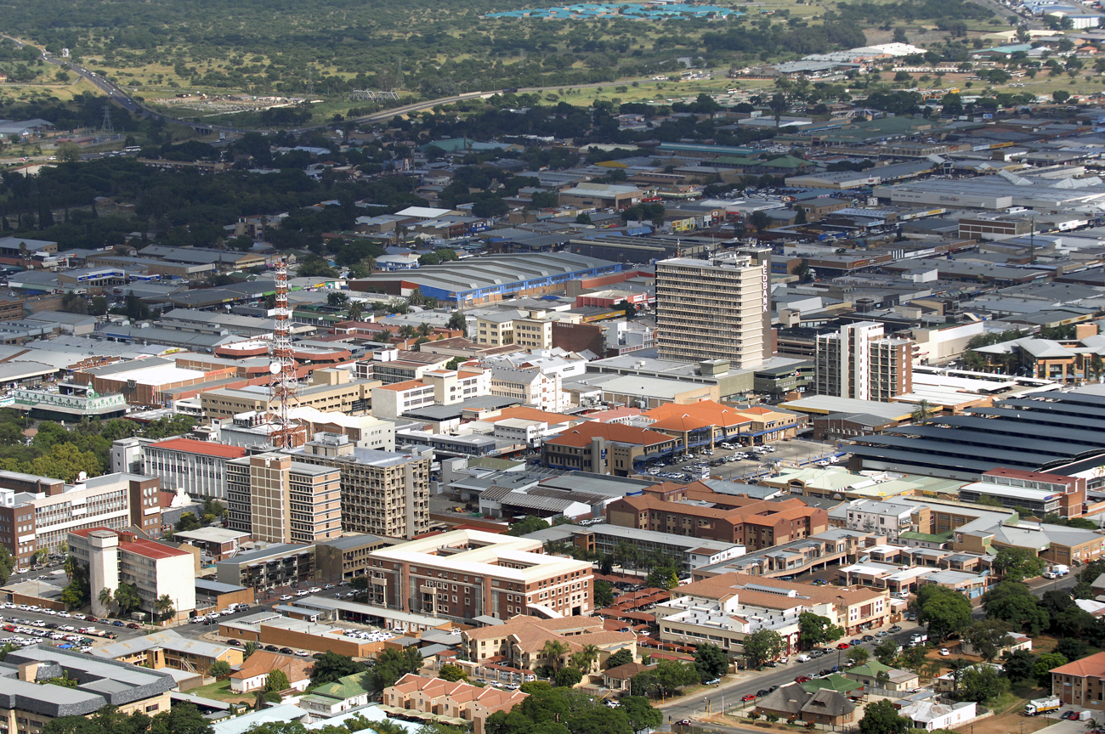
3. BRIEF PROFILE OF THE MUNICIPALITY
The population size is 797 127, with 239 116 households

Slide 9
3. BRIEF PROFILE OF THE MUNICIPALITY
Polokwane Municipality is situated in the central part of the Limpopo Province.
The municipality shares the name with the biggest town in Limpopo called Polokwane. Locally it shares borders with three other local municipalities within Capricorn District as well as local municipalities in Mopani and Waterberg Districts.
It is the largest metropolitan complex in the north and a major economic centre with 45 wards. Its proximity to the neighbouring countries of Botswana, Zimbabwe, Mozambique and Swaziland makes it a perfect gateway to Africa and an attractive tourist destination. The settlement types indicate that it is more urban than rural.

Slide 10
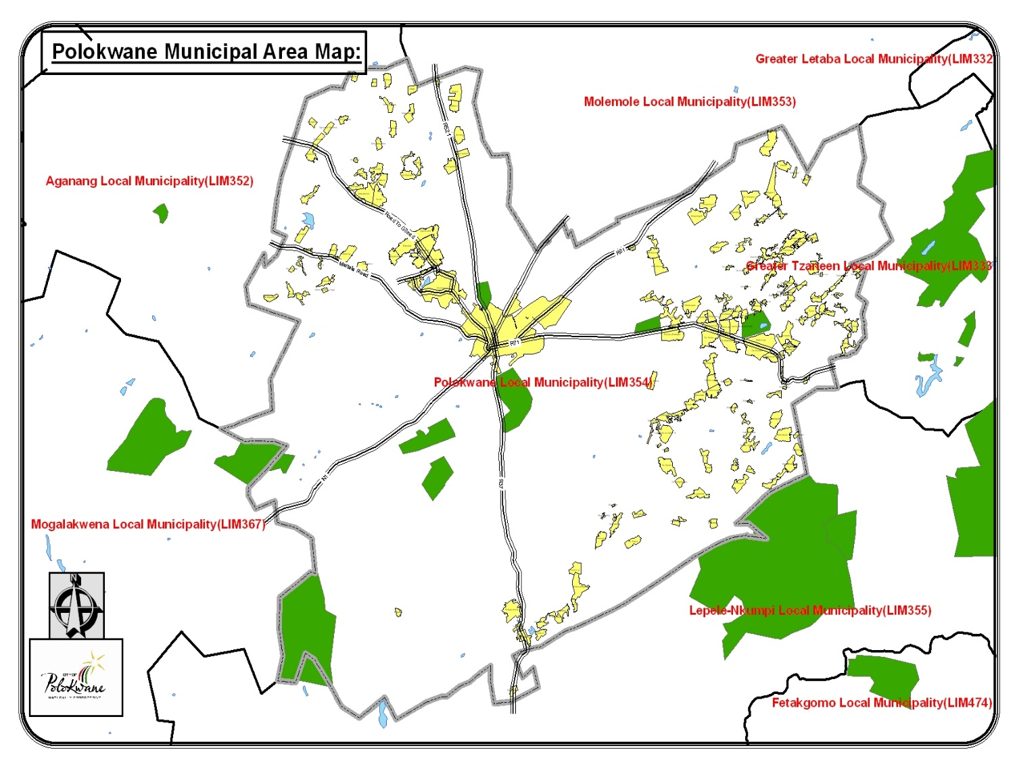
4. New Polokwane Map
Incorporated Aganang
Area

Slide 11
5. Socio-Economic Profile
The population is standing at 797 127, persons as per Stats SA Community Survey 2016.
A considerable portion of the municipal population, almost 40%, live in the Polokwane-Seshego Urban Complex.
The urban population is growing faster (5% per year in the City) than the rural population (1.6% per year), mainly due to migration.
The total number of households for Polokwane has increased from 130 361 in 2007 to 178 001 in 2011 and 239 116 households in 2016.
Statssa was supposed to have conducted the 2020 census and release the results in 2021, due to COVID 19 the census was not conducted in 2020. The total number of households and population will be updated when Statssa avails new information.

Slide 12
6. Population growth trends.
 | 2019 | 2001
Total population | 797 127 | 508,277
Young (0-14) | 30,1% | 36%
Working Age (15-64) | 64,8% | 64,8%
Elderly (65+) | 5,1% | 4,9%
Dependency ratio | 54,3 | 69%
Sex ratio | 92,5 | 86,9

Slide 13
7. Economic Information
The priority of the Municipality is to render operational the socio-economic environment in order to facilitate the creation and the development of economic activities;
facilitate investment promotion to retain the income of the local economy (i.e. plugging the leaks in the local economy);
develop human capital (i.e. skills development focused on the needs of the local economy);
to provide economic development (developmental support to community based initiatives, cooperatives etc.);
facilitate SMME development; identify and support business clusters and business opportunities;
facilitate and ensure contacts, links and or exchanges with possible local, national and international economic partners; attract inward investment and to promote Polokwane as a tourist destination.

Slide 14
7. Economic activity per sector
Economic Activity by Sector R`000
Sector | 2012/13 | 2013/14 | 2014/15 | 2015/16 | 2016/17 | 2017/18 | 2018/19 | 2019/20
Agric, forestry and fishing | 386,940 | 393,886 | 556 239 | 505909 | 766,261 | 912395 | 1091336 | 963243
Mining and quarrying | 44,221 | 50,295 | 1 134 594 | 1593220 | 3,285,927 | 3728794 | 3939113 | 4344427
Manufacturing | 876,349 | 918,237 | 1 251 780 | 1848877 | 2,672,253 | 2517981 | 2559967 | 2561676
Wholesale and retail trade | 2,630,622 | 2,785,146 | 7 375 350 | 9516169 | 12,892,600 | 13671496 | 15303898 | 15883777
Finance, property, etc. | 3,707,642 | 5,251,150 | 8 516 734 | 10232846 | 11,784,483 | 13115394 | 14020043 | 14972571
Govt, community and social services | 4,792,654 | 4,868,204 | 10 306 915 | 13877391 | 18,699,546 | 19684412 | 22211135 | 22859413
Infrastructure services | 3,651,054 | 6,704,870 | 3 956 409 | 5681039 | 8,071,073 | 3986914 | 7760838 | 11247353
Total | 16,089,482 | 18,186,642 | 33 098 021 | 43255452 | 58,172,144 | 57617386 | 70090329 | 72832461

Slide 15
7. ECONOMIC EMPLOYMENT PER SECTOR
Economic Employment by Sector Jobs
Sector | 2012/13 No. | 2013/14 No. | 2014/15 No. | 2015/16 | 2016/17 | 2017/18 | 2018/19 | 2019/20
Agric, forestry and fishing | 12,928 | 11,675 | 8 856 | 9526 | 10,785 | 10710 | 11665 | 11537
Mining and quarrying | 179 | 3,342 | 2 600 | 3990 | 3,292 | 3387 | 3012 | 3348
Manufacturing | 5,256 | 10,143 | 10 220 | 10713 | 18,433 | 12366 | 11002 | 10888
Wholesale and retail trade | 11,265 | 27,336 | 29 510 | 36385 | 63,032 | 40452 | 43611 | 44293
Finance, property, etc. | 8,681 | 19,079 | 21 112 | 25631 | 30,072 | 29498 | 31004 | 29861
Govt, community and social services | 37,394 | 35,617 | 38 057 | 54721 | 88,318 | 57978 | 78 965 | 79343
Infrastructure services | 9,744 | 39,077 | 12 516 | 16679 | 39,645 | 12879 | 18139 | 17545
Total | 85,448 | 146 269 | 122 870 | 157645 | 253,577 | 167270 | 197405 | 196816

Slide 16
8. Annual Report Legislative framework
The 2019/20 Annual Report is compiled in terms of Section 121 of the MFMA and Section 46 of the MSA.
The purpose of the Annual Report is to give account of activities that the municipality undertook during the year under review (2019-20)
The activities were guided by the Integrated Development Plan and the Tabled Budget that Council approved and adopted in May 2019.

Slide 17
9. STATUTORY ANNUAL REPORT PROCESS
No. | Activity | Timeframe
1 | Consideration of next financial year’s Budget and IDP process plan. Except for the legislative content, the process plan should confirm in-year reporting formats to ensure that reporting and monitoring feeds seamlessly into the Annual Report process at the end of the Budget/IDP implementation period. | July 2020
2 | Implementation and monitoring of approved Budget and IDP commences (In-year financial reporting).
3 | Finalise 4th quarter Report for previous financial year
4 | Submit draft Annual Report to Internal Audit and Auditor-General
5 | Municipal entities submit draft annual reports to MM
6 | Audit/Performance committee considers draft Annual Report of municipality and entities (where relevant) | Oct 2020
8 | Mayor tables the unaudited Annual Report
9 | Municipality submits draft Annual Report including consolidated annual financial statements and performance report to Auditor General.
10 | Annual Performance Report as submitted to Auditor General to be provided as input to the IDP Analysis Phase

Slide 18
11 | Auditor General assesses Draft Annual Report including consolidated Annual Financial Statements and Performance data | Feb 2021
12 | Municipalities receive and start to address the Auditor General’s comments | June 21
13 | Mayor tables Annual Report and audited Financial Statements to Council complete with the Auditor- General’s Report
14 | Audited Annual Report is made public and representation is invited
15 | Oversight Committee assesses Annual Report
16 | Council adopts Oversight report | Aug 21
17 | Oversight report is made public
18 | Oversight report is submitted to relevant provincial councils
19 | Commencement of draft Budget/ IDP finalisation for next financial year. Annual Report and Oversight Reports to be used as input. | Sept 21

Slide 19
10. Audited financial performance against original and revised budget for the 2019/20 financial year

Slide 20
10. Financial overview
The municipality is financially stable for now. The slow economic environment and the rising and uncertain cost in the provision energy necessitated a revised strategical approach in ensuring financial sustainability.
The strategic approach involves the establishment of a revenue protection unit to optimise revenue billing and collections, cost containment measures and innovations to curb the high cost of Eskom bills.
These strategies will have a positive impact on the financial sustainability and viability of the municipality in the long term.

Slide 21
10. Key financial achievements
Spending of conditional grants of 94% was achieved at the end of the financial year as opposed to the 97% achieved in the prior financial year.
The regressed percentage spending during the financial year was due to the reduced productivity throughout South Africa because of the imposed National lockdown owing to the current pandemic.
The following grants had reflected a lower percentage spend comparative to 2019;
Public Transport Network Grant (73% as compared to 100%),
Neighborhood Development Partnership Grant (48% as compared to 86%),
Water Services Infrastructure Grant (92% as compared to 100%) and
Regional Bulk Infrastructure Grant (97% as compared to 100%).
Despite these grants reflecting a reduced spending, the municipality has also noted a 100% spend relating to the following grants:
the Finance Management Grant,
Extended Public Works Programme Integrated Grant,
Integrated Urban Development Grant, Infrastructure Skills Development Grant,
Municipal Disaster Grant and Social Housing Regulatory Authority Grant totalling around, as a whole, R448 million spent at year end.
These grants or programmes contribute significantly to the socio-economy of the City of Polokwane considering that expenditure on community services is the number one contributor to a positive performance of the local GDP/GVA.

Slide 22
10. Key financial achievements
The Office of the CFO continued to maintain the efficiency and effectiveness of the internal controls around the SCM procurement processes.
R476 million of the irregular expenditure as recorded in the annual financial statements emanated from the previous financial years dating back from the 2013/14 financial year and was incurred before the SCM reforms introduced during the 2016/17 financial year.
Because of the reforms the municipality recorded no new irregular expenditure as per the annual financial statements for the 2017/18 and 2018/19 financial years as the movements in the balances were as a result of those contracts procured since the 2013/14 financial years.
The irregular expenditure of R1.4 million as disclosed in the 2019/20 financial emanated from a non-compliance in deviations from the provision of training courses. However, no losses were incurred as the services were rendered . The procurement processes still remain effective to prevent and identify irregular expenditures.

Slide 23
10. Key financial achievements
Unauthorized expenditure incurred in 2019/20 is R462m. The unauthorized expenditure is due to non-cash items due to the requirements of the accounting standards i.e. transactions relating to actual cash expenditure were not unauthorised and was made in accordance with the Council approved budget. Appropriate controls were implemented to ensure that no cash unauthorized expenditure is incurred.
Council has already approved the write off of R437 million of the opening balances as disclosed in the annual financial statements.
No Fruitless and wasteful expenditure was incurred by the Polokwane municipality in the 2019/20 but is R22 000 was incurred by its subsidiary PHA.
This related to interest incurred, insurance premiums paid and overpayment of salary to a deceased employee by the subsidiary.

Slide 24
10. Key financial achievements
Continued success of the smart metering programme resonated in the current financial year where a 25% real growth (over and above the tariff increases) was noted in pre-paid sales/advance cash over , and a steep reduction in electricity distribution losses of almost R60 million
Successful migration into a new financial system i.e. Munsoft
The City of Polokwane was the first municipality in the country to successfully implement the mSCOA budget module and continues to do so to date .
Financial statements do not have this information. I am not sure if Mr Shokane will be able to help
Distribution losses increased. Therefore this needs to be removed.
I want to remove this. For Munsoft - it seems outdated. I am not sure what is status with MSCOA budget module implementation

Slide 25
11. Key challenges (financial)
Significant challenges continued in revenue collection due to socio economic factors in the Mankweng township the significant impact of the COVID 19 pandemic. The municipality incurred losses in cash inflows in the region of R65 million due to the Hard lockdown imposed in March 2020. The impact is still felt to date where the municipality is 7% down in billable revenue relative to pre-COVID 19 figures.
The municipality has maintained qualified audit opinion. This was mainly due GRAP/accounting interpretation issues in the valuation report relating to assets as well as the useful lives estimate of a certain class within property, plant and equipment. Several reforms have been developed for implementation and are discussed below under reforms

Slide 26
12. ANALYSIS OF REVENUE
The total of own municipal revenue (total revenue less grants and donations) increased from R 1.989 billion (2018/19) to R 2.219 billion (2019/20) representing an increase of 15% from the 2018/19 financial year.
This increase is primarily due to the increase in the interest charged on outstanding debtors balances, the impact of the increase in tariffs across the board and a credible billing system that is now able to record revenue and the impact of the new valuation roll which increased assessment rates across the jurisdiction of the municipality

Slide 27
12. ANALYSIS OF REVENUE (cont..)
Revenues from investments saw an increase due to the disposal of poor performing assets while interest from outstanding debtors also increased due to the consumers inability to pay on time as a direct consequence of the depressed economic environment. Revenue from consumption (i.e. service charges) saw a positive growth of 12%.
This can be attributed to more accurate billing and the move to pre-paid consumptions.
The gross profit percentage of consumption revenue (electricity and water) remained at 27% consistent with the prior financial year. This indicates that the municipality is able to absorb the increases from the utilities for now.
However, uncertainty remains if Eskom continues implementing hefty increase in the short term. These hefty increases will provoke businesses and households to migrate to alternative energy sources such as solar panels that would further constrain the revenue sources of the municipality going forward.
The main revenue sources that have influenced the level of accrued revenue were property rates, electricity, water, refuse removal and other income which accounted 50% total revenue in the 2019/20 financial year while at same time government grants accounted 50% of total revenue. This is consistent with the prior financial year.
Reforms
To address the socio economic challenges, a robust communication and consultative strategy was developed and implemented in the financial year where the complaints of the township (Mankweng community) are being addressed in accordance with our policies and to correct any identified deficiencies to ensure revenue collection. This project is expected to be finalised during the second half of the subsequent financial year.
The successful migration into the new financial system Munsoft created a seamless intergration between the credit control software and the new system. This ensured real time update of accounts and enabled cut offs on a daily basis to enhance cash flows.
The revenue protection unit is at Implementation stage and is considered the main driver in our revenue enhancement strategy. The use of technology such as identification of unrealistic non buying/low buying customers, meter tempering and arrear collection through smart technology are some of the strategies that already in progress to increase cash flow revenues

Slide 28
12. Total revenue for 2019/20

Slide 29
13. Financial position 2019/20

Slide 30
14. Liquidity management
The municipality recorded a ratio of 0.90 [current assets/current liabilities] compared to 0.89 of the previous year. The reason for the low ratio is that a significant amount of debtors was considered as impaired while the creditors balance at year end increased.
However, this ratio is adjusted upwards to 1.38 when considering a detailed cash analysis

Slide 31
15. Analysis of trade and accounts receivable component of financial position
Total debt book increased by R94million in 2019/20 financial year. 90% of the increase is attributable to receivables from property rates which is due to supplementary valuation rolls and the delay on payment by the customers. The delay on payment of bills is further compounded by the negative effects of the National Lockdown and the Mankweng debtor book.

Slide 32
16. ANALYSIS OPERATING EXPENDITURE COMPONENT OF FINANCIAL STATEMENT

Slide 33
17. Grants performance

Slide 34
18. Repairs and maintenance

Slide 35
19. Cash flow management

Slide 36
20. Capital expenditure

Slide 37
21. Capital expenditure (cont…)

Slide 38
22.Performance against IDP and SDBIP targets for 2019/20 financial year (original and revised/adjusted targets) high level overview.

Slide 39
22. Summary of kpas performance
No | Key Performance Area | Number of Planned Indicators | Number of Indicators Achieved | Number of Indicators Not Achieved
1 | Municipal Transformation and Institutional Development | 6 | 3 (50%) | 3 (50%)
2 | Basic Services Delivery | 16 | 7 (43%) | 9 (57%)
3 | Local Economic Development | 6 | 1 (17%) | 5 (83%)
4 | Financial Viability | 13 | 7 (53%) | 6 (47%)
5 | Good Governance and Public Participation | 24 | 10 (42%) | 14 (58%)
Total |  | 65 | 28 (43%) | 37 (57%)

Slide 40
22. Performance on national general key performance indicators
National General Key Performance Indicator | Annual Target 2017/18 | 2017/18 Actual Performance Achieved | Baseline 2018/19 | Annual Target 2018/19 | Actual Performance Achieved 2018/19 | Annual Target 2019/20 | Actual Performance 2019/20
Increase percentage of Households with access to water by 1% (2391 HH) by 30 June 2020 | 83.4% (199422) (2360 HH connections) | 83.00% (198480 HH) | 3009 1.26% | 0.75% (1800HH) | 0.82 A total of 1967 households were provided with Water. (1614 rural households and 353 urban connections achieved) | 1% 2391 Households | 0.89% A total of 2146 households were provided with Water. (1827 rural households and 319 urban connections achieved)
Increase percentage of Households with access to sanitation by 0.61% (1578 HH) by 30 June 2020 | Approximately 2295 VIP toilets. 60.46% (144569) | 60.34% (144301 HH) | 3348 1.40% | 1.15% (2745) [510 & 490 - Sebayeng; 617 - Chuene/Maja; 600 - Mankweng; 528 Moletji] | 1.25 A total of 3002 households were provided with sanitation. (2745 VIP units were completed and 257 urban connections achieved) | 0.61% (1578 HH) | 1.15% A total of 2753 households were provided with sanitation. (2432 VIP units were completed and 321 urban connections achieved)

Slide 41
22. Performance on national general key performance indicators
National General Key Performance Indicator | Annual Target 2017/18 | 2017/18 Actual Performance Achieved | Baseline 2018/19 | Annual Target 2018/19 | Actual Performance Achieved 2018/19 | Annual Target 2019/20 | Actual Performance 2019/20
Increase percentage of Households with access to electrification by 0.97% (2333 HH) by 30 June 2020. | 96.69% (231217) (2623 HH connections) | 96.23% (230177 HH) | 1604 0.67% | 0.99% (2367) | 0.56 Total of 1344 provided with electricity (305 Urban connections and 1039 Rural connections) | 0.97% (2333 HH) | 0.78% Total of 1874 provided with electricity (244 Urban connections and 1630 Rural connections)
Percent of Households with access to waste removal services 0,04% (100 HH) by 30 June 2020 | 43.08% (103015) | 43.26 (103463 HH) | 476 (0.20%) | 0.08% (200 HH) | 0.23% New (541 households ) received weekly refuse removal service | 0,04% (100 HH) | 0.06%
Percentage of Households with access to free basic services to all qualifying households in the municipal's area of jurisdiction | 45 000 | 34023 | 30000 (100%) | 100% | 100% of indigent registered received benefits | 100% of indigent registered received benefits | 100%

Slide 42
23. Performance challenges 2019/20
Section 46 (1) of the Local Government: Municipal Systems Act, Act 32 of 2000 requires municipalities to prepare the performance report that reflects the performance of the municipality and that of its external service providers. Polokwane municipality wishes to highlight that some projects were delayed during the 2019/20 implementation year. The said projects were not completed on time due to various challenges such as:

Slide 43
23. Performance challenges 2019/20 (cont….)
Poor performance of service providers leading to delays.
Terminations of contracts.
Delays in approvals of technical reports.
Delays in the approval of Implementation Readiness Status (IRS) documents prevent the municipality from conducting long term planning on water and waste water projects.
Stopping of projects by community members.
Prolonged procurement process of service providers in some instances.
Completed but dysfunctional water supply and waste management projects due to outstanding electricity connections by Eskom.
Vandalism of completed infrastructure.
Project stoppage due to national lockdown (Recent and critical challenge).
The sites have to comply with new OHS protocols and Guidelines of the National Institute for Occupational Health and Communicable Diseases taken, which has a potential a delay in resumption of projects after issuing of work permits.

Slide 44
24. Management Measures taken to improve performance in the 2019/20 Financial Year
The municipality continues to improve projects planning across all funding sources. Project planning for each financial year commences in the third and fourth quarter in order to ensure that project implementation is achieved by the first quarter of each implementation year.
The municipality uses a multiyear implementation approach for medium to long term projects with the aim of improving the rate of service delivery and back lock eradication.
The municipality further uses a three-year panel for professional service providers for project preparations and planning.
Putting technical support in place for interventions for poor performing projects.
Adopting new strategies to maintain business continuity while working remotely to combat the spread of COVID 19 virus in the workplace.

Slide 45
25. Auditor General’s Report
2019/20
Financial Year and Audit Opinion

Slide 46
25.1 Auditor General’s Report
FINANCIAL YEAR | AUDIT OUTCOME
2013/2014 | Qualified
2014/2015 | Unqualified ( Matters of Emphasis)
2015/2016 | Unqualified ( Matters of Emphasis)
2016/2017 | Qualified
2017/2018 | Qualified
2018/2019 | Qualified
2019/2020 | Qualified

Slide 47
25.2 basis for qualified opinion
Property, plant and equipment
Investment property
Revenue and receivable from exchange transactions
Emphasis of matters
Restatement of corresponding figures
Significant uncertainty
Events after reporting date
Material losses
Other Matters
Unaudited disclosures notes
Unaudited supplementary schedules

Slide 48
25.3 Progress with remedial action implemented to address material issues reported
Polokwane Municipality developed the Audit Action Plan to address all the issues raised in the 2019/20 audit report.
The implementation of the Audit Action Plan is monitored through Audit Steering Committee which is held every Monday with all executive managers, Municipal Manager, Internal Audit, risk management, and the Executive Mayor
Engagement with the AGSA to ensure an interim audit is performed with an early start to the audit in order to avoid audit findings towards the end of the audit where enough time is not afforded to address key audit findings.

Slide 49
POLOKWANE HOUSING ASSOCIATION
ANNUAL REPORT FOR 2019-20

Slide 50
26. OVERVIEW OF PHA
The Polokwane Housing Association (SOC) Ltd was previously registered and established as a Section 21 Company in terms of the Companies Act in 2002 and in 2005 registration was changed to Ga-Rena Rental Village (proprietary).
The registration and establishment was subsequently changed and PHA is now registered as a SOC Limited company in terms of section 86 of Municipal Systems Act. The registered name is Thabatshweu Housing Company (SOC) Ltd REG NO (2005/012521/07) trading as Polokwane Housing Association.

Slide 51
26.1 MANDATE OF PHA
• integrated Human Settlements
• Social and Non-Social Housing
• Rental housing units within the Gap Market

Slide 52
26.2 BOARD COMMITTEES OF PHA
Board Committees serve as a vital and important tool in aiding the Board. After all, a Committee’s intended mission is to support and assist the Board in carrying out its responsibilities. Dysfunctional Committees however, can have the adverse effect, creating long-lasting negative issues for both the board and the community at large.
The explanation below gives clarity to the roles, responsibilities and performance of the various Board Committees during the term under review.
The Board is supported by the following committees:
• Property, Contracts and Projects, (PCP)
• Finance and Risk, (FRC)
• Human Resource & Remuneration (HR&REMCO), and
• Social and Ethics

Slide 53
PHA PROJECTS

Slide 54
26.3 ANNADALE EXT 2 SOCIAL HOUSING PROJECT BRIEF
Motheo construction group was appointed to construct 494 residential units comprising eleven blocks at Annadale Extension 2 (Ga Rena Phase 2). The project started on the 1st February 2019. Despite normal construction site challenges the project was running smoothly until the site was closed due to the national lockdown.
Progress made by June 2020
The actual work was 12% completed
Brickwork to block A and B were 100% complete on second floor
Brickwork to C and D were 100% complete on first floor • Brickwork to block E and H were ground floor 75% complete
Commenced with brickwork of block F
Raft foundation to block G to commence
Services to block J and K complete
Layer works to block L
Impact of – 19 on construction site The site was closed in March 2020 due to the national lockdown announced by the President of the country. All construction employees vacated the site. Security remained behind to guard against theft and banalisation of the site. The project was opened on the 1st of June 2020 and it was delayed with about sixty (60) days, due to the lockdown and, as a result, the completion date had to be revised.

Slide 55
26.3 POLOKWANE EXT 76 SOCIAL HOUSING PROJECT
Overview The successful bidder for Polokwane Ext 76 Social housing project proposed 240 social housing units. The final construction drawings are based on the said number. The grant application from Social Housing Regulatory Authority (SHRA) approved grants equal to 240 units. A monthly royalty fee of 30% payable to PHA from gross rental collections was also negotiated with LADIRA JV. (La-Dira) After the procurement process, La-Dira / NJR JV was duly notified of the PHA / Municipality’s intent to appoint them subject to completion of the public participation process in terms of Section 33 of the MFMA.

Slide 56
26.3 POLOKWANE EXT 107 GAP HOUSING PROJECT
The Design, Built, Finance, Operate and Transfer (DBFOT) option on Extension 107 was the chosen approach approved by PHA and its stakeholders. Polokwane Housing Association contributed land towards the DBFOT concessionary agreement. The Concessionaire will transfer properties to the new home owners and pay over a royalty fee of 5% to PHA after the successful transfer. The assumption is that the developer will sell off the plan and thereby only require minimum capital outlay upfront which should reduce the amount to be borrowed.
After the completion of procurement processes, VHARANANI Properties was duly notified of the PHA / Municipality’s intention to appoint them, subject to completion of the public participation process in terms of Section 33 of the MFMA.
A royalty fee of 7% payable to PHA from gross sales value of properties after successful transfer, was also negotiated with VHARANANI.
Vharanani Properties is the preferred bidder for this project and engagement with the company is underway to finalise
the contract. The Design Build Finance Operate and Transfer (DBFOT) procurement process option on Extension 107 yielded the following results:

Slide 57
PHA PERFORMANCE SUMMARY FOR 2019/20

Slide 58
26.3 PHA KEY PERFORMANCE AREAS RESULTS FOR 2019/202
KPA | No of targets as per Revised APP | Targets achieved | Targets not achieved | POE not provided/ Insufficient
Service Delivery | 6 (100%) | 6 (100%) | - | -
Financial Viability | 5 (100%) | 3 (60%) | 2 (40%) | -
Governance and Transformation | 16 (100%) | 14 (87%) | 2 (13%) | -
Total | 27 | 23 | 4 | -
Total in percentage | 100% | 85% | 15% | -%

Slide 59
26.3 PHA AUDIT OPINION
PHA received an UQUALIFIED AUDIT OPINION for the 2019/20 financial year.
Matters of emphasis
Restatement of corresponding figures
Material impairment

Slide 60

Q & A

